Slide 1
Visual Instruction Tuning

Slide 2
Introduction
Instruction Tuning: tuning LLMs to better follow instructions - fine tuning a model specifically on examples where it is told to do something.
Zero Shot: a model is asked to do a task it has never seen before, without ever being specifically fine tuned to that task
An increased interest has emerged in developing language augmented foundation vision models - utilizing both Computer Vision and text processing to interact and adapt to user instructions involving multiple modes.
Visual Instruction-Tuning: extend instruction tuning to a language-image multimodal space

Slide 3
Introduction Continued
Visual Instruction Tuning - extending instruction tuning to the multi modal space
Contributions:
Multimodal instruction following data - there is a very sparse availability of visual language instruction-following data. This paper generates a pipeline to convert image-text pairs to be usable for instruction tuning
Large multimodal models - CLIP connects images and texts, learning what images mean in human language by training on image caption pairs.
Benchmark - produces benchmark for instruction following
Open Source - the instruction data is open source.

Slide 4
Related Work
Multimodal Instruction-Following Agents:
End-to-end trained models - combining different modes of data, by giving instructions as text, but making agent act upon an image - different forms.
This paper wants to do that multimodal processing for MULTIPLE tasks at once, not just edit an image, but process it on text.
Instruction Tuning: Following new instructions better is zero-shot or few shot generalization, meaning the model has not seen multimodal processing questions before
instruction tuning has not been used with models that understand BOTH images and text together.

Slide 5
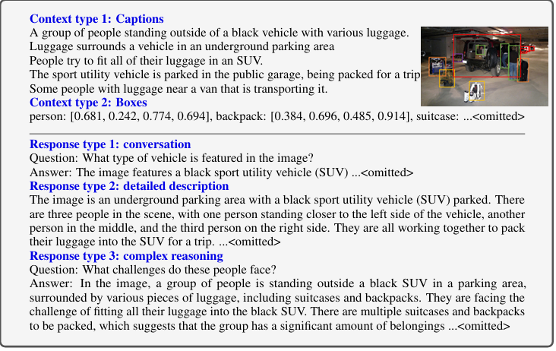
GPT Assisted Visual Instruction Data Generation
The authors use Chat GPT to give an image X, and its associated caption Xc, a set of questions to instruct the multimodal model to describe the image’s content.
The authors ask multimodal to give description on an image, but this question was generated by an LLM which does not take in the image
Almost like a Meta Prompt - using LLMs processed on text to create the instruction following data that will be used to train a multimodal model.
Image Captions: describe the visual scene
Bounding Boxes: localize objects in a scene and label the objects in the data

Slide 6
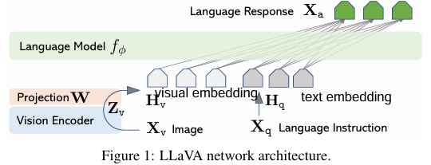
Visual Instruction Training
Xv is the image input, which goes to Vision encoder, outputting a visual feature vector.
the projection layer converts the visual feature vector (Zv) into a format that a LANGuage model can understand.
H_v is the visual embedding compatible with language.
The text input Xq is language that goes directly to language model, converted to text embeddings. the model combines the visual (embedding) + language feature, feeding into a language model, producing a language response

Slide 7

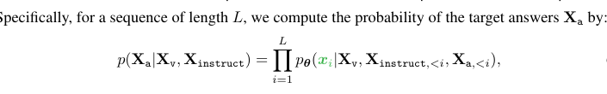
Training Continued
This setup defines how to structure the input for each turn in a visual dialogue:
In the first turn, the model is “introduced” to the image and question.
In later turns, the model just sees the next user question, and continues the dialogue based on what it already knows.
Given the image and the question, predict the next word in the answer.”
this is a standard way of training language models — called auto-regressive training — just extended to include images as part of the input.

Slide 8
LLaVa Training Pipeline: Pre Training for Feature Alignment and Fine-Tuning End to End
Stage 1: Pre-training (Feature Alignment)
The model learns to connect images with language.
It looks at an image and a question, then tries to match it to the original caption.
The goal is to help the model understand how to “read” images in a way the language model understands.
At this stage, only a small part of the model is trained; the rest stays frozen
Stage 2: Fine-tuning (End-to-End Learning)
Now the model learns to actually follow instructions involving images and text.
It's trained on examples like:
Conversations with images
Science questions that use diagrams or pictures
This stage teaches the model to reason, explain, and answer questions using both visual and text input.

Slide 9
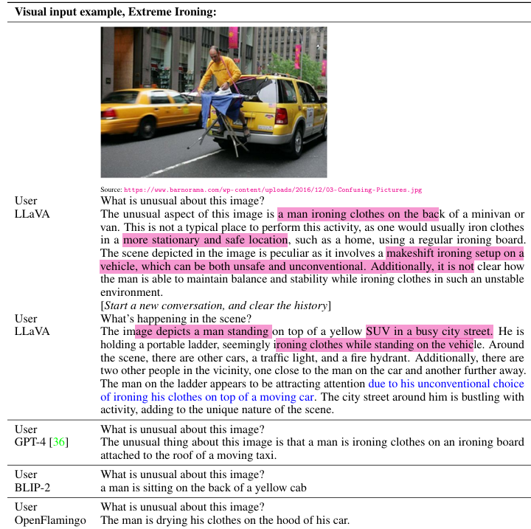
Experiment: Multimodal Chatbot
Represents the prompt the user gives and what LLaVa says in response
Compared to Blip-2 and Open Flamingo, LLaVA more accurately follows user instructions

Slide 10
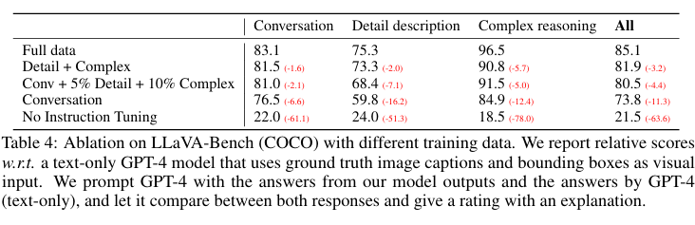
Quantitative Reasoning
How the Evaluation Works
Input Triplet: An image, a related question, and its correct description.
Two Predictions:
One from LLaVA (uses the image and question).
One from GPT-4 (text-only) that only sees the description (no image).
Judging:
GPT-4 compares both responses.
It scores each on helpfulness, relevance, accuracy, and detail.
Final score: 1 to 10, higher is better
🧠 Why Use GPT-4 as a Judge?
It gives consistent, explainable ratings.
Helps set a theoretical upper bound (what’s possible without vision)
Full Data leads to the best results.
LLaVA outperforms other models like BLIP-2 and OpenFlamingo.
GPT-4 scoring allows a fair benchmark across models and tasks.

Slide 11
LLaVA-Bench and Limitations
LLaVA Benchmark & Performance Insights
Benchmark Setup: Evaluated LLaVA using 90 questions across three types: Conversational, Detailed Description, and Complex Reasoning.
Key Findings:
+50 points improvement from instruction tuning.
+7 points gained by adding detailed and reasoning questions, also boosting conversational skills.
Best performance achieved with all question types: 85.1% accuracy.
LLaVA-Bench (In-the-Wild):
24 diverse images and 60 questions in real-world scenarios.
LLaVA outperformed BLIP-2 (+29%) and OpenFlamingo (+48%) on complex reasoning.
Achieved 81.7% on reasoning questions and 67.3% overall.
Limitations: Struggled with high-resolution image understanding and complex semantics, e.g., incorrectly identifying yogurt in fridge example.

Slide 12
Science QA
ScienceQA Benchmark Summary
ScienceQA is a large multimodal dataset with 21K+ multiple-choice questions across diverse subjects and skills.
It includes both visual (images, plots) and textual content to test real-world reasoning.
LLaVA nearly matches the best-performing model (MM-CoT), showing strong reasoning and visual understanding.
GPT-4 performs well using text-only input, but struggles with visual questions due to lack of image processing.
Two hybrid approaches were tested:
Fallback: Use LLaVA when GPT-4 can't answer → maintains strong accuracy.
GPT-4 as Judge: Compare LLaVA and GPT-4 answers, then let GPT-4 choose → leads to best overall results.
New state-of-the-art performance achieved by combining strengths of both models.
Key takeaway: Text-only models like GPT-4 can enhance multimodal systems through intelligent ensembling.

Slide 13
Conclusion
Key Takeaways: Visual Instruction Tuning with LLaVA
Introduced a new automatic pipeline to generate image-language instruction-following data.
Trained LLaVA, a multimodal model that follows human intent to complete visual tasks.
Achieved state-of-the-art performance on the ScienceQA benchmark.
Demonstrated strong visual chat capabilities after fine-tuning on multimodal dialogue data.
Presented the first benchmark focused on multimodal instruction-following ability.
Work emphasizes real-world visual tasks, serving as a foundation for future research.
Encourages the development of more powerful multimodal AI systems.

